Slide 1
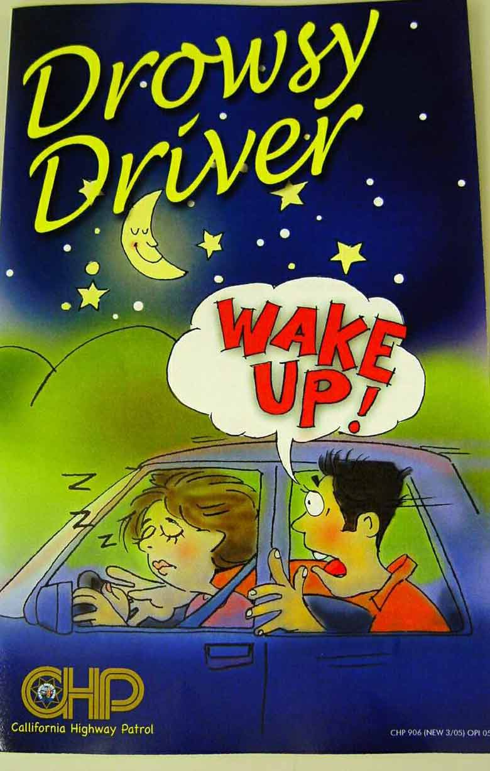
April 6, 2021
Tuesday
Today's Lesson:
Part I: Drowsy Driver Awareness Day

Slide 2
https://www.youtube.com/watch?v=RCnK1eYfkTQ
Chinese students a day at school
https://www.youtube.com/watch?v=RCnK1eYfkTQ

Slide 4
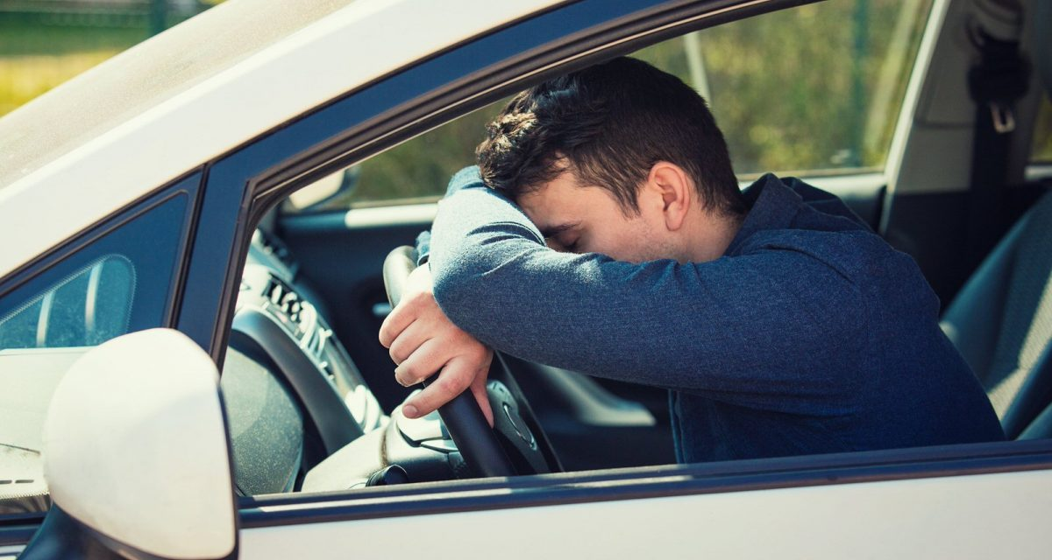
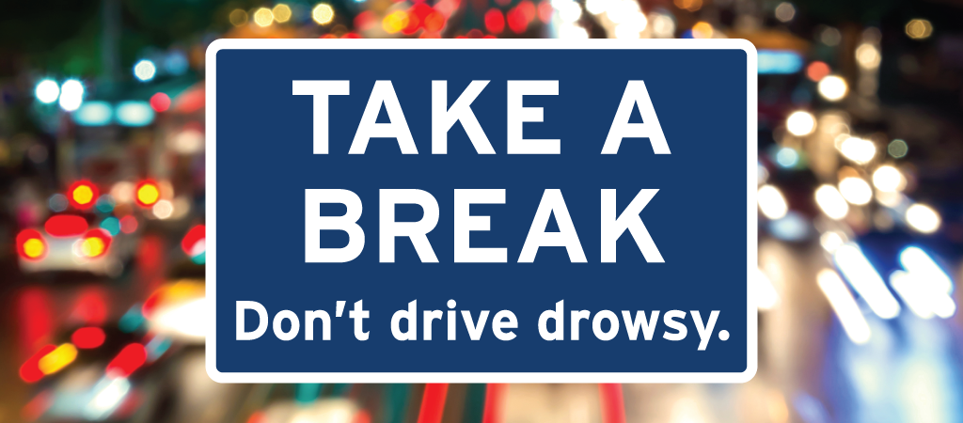

Slide 5
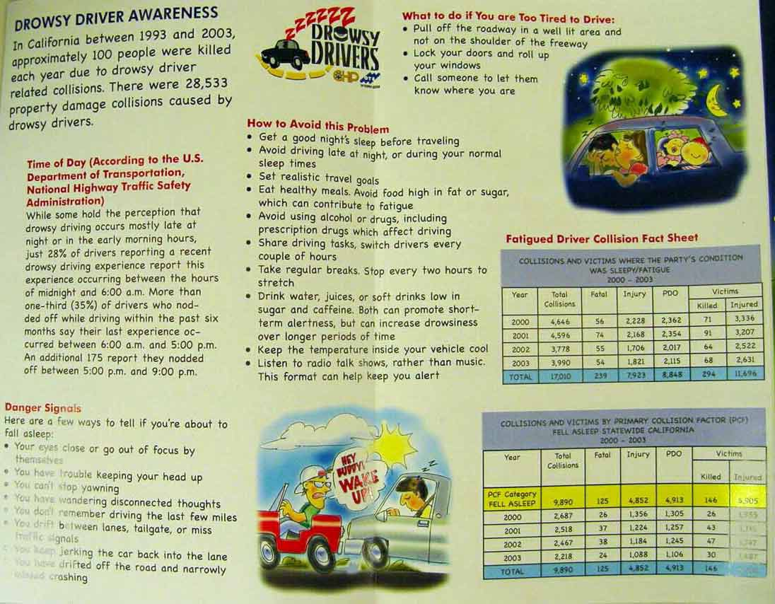

Slide 6






1. California has an awareness days / day that all countries around the world should have.
2. It is Drowsy Driver Awareness Day and it happening / happens on April 6 every year.
3. Its aim is to raise awareness of the dangers of driving your car (or riding your motorcycle) for long periods / period without a rest.

Slide 7

4. It also highlights the dangerous / dangers of driving when you are very tired.
5.The day was thought up / down by former California Highway Patrol officer Phil Konstantin.
6. He witnessed many accidents that happened because of tired / tiredness and had experience of falling asleep at the wheel and narrowly avoids / avoided a serious accident

Slide 8
8. He warned: “It can happening / happen to anyone.”

Slide 9


Slide 10

April 7, 2021
Wonderful Wednesday
Today's Lesson:
Part I: No House Work Day
Part II: What is High Speed Rail and Bullet Train?

Slide 11


No House Work Day

Slide 12
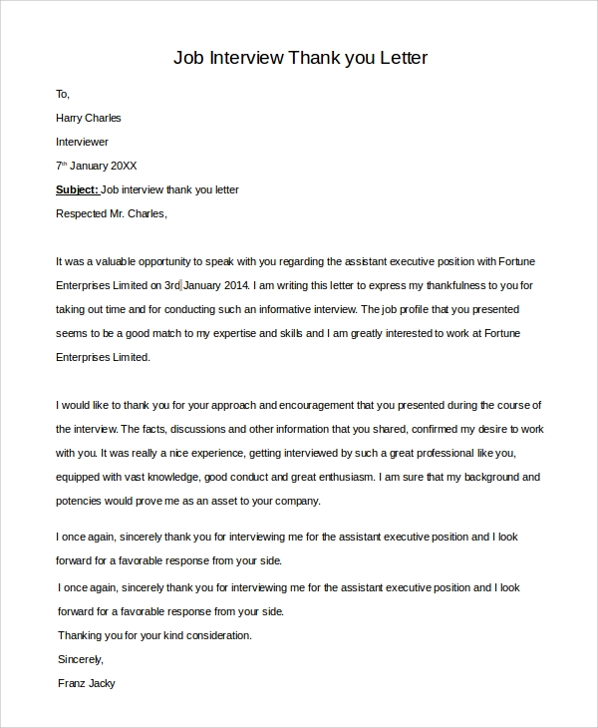


Slide 13
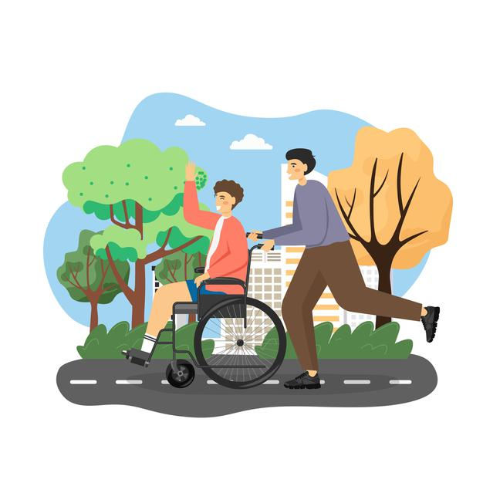
No House Work Day What is this day?
National No Housework Day is celebrated on April 7 of every year. This day is marked by doing no household chores.
Housework is the management of duties and chores involved in the running of a household, such as cleaning, cooking, home maintenance, shopping, laundry and bill pay.
These tasks may be performed by any of the household members, or by other persons hired to perform these tasks.

Slide 14

No House Work Day History Behind this Day
National No Housework Day was believed to be created by Thomas and Ruth Roy and are listed in Chase’s Calendar of Events.
This calendar has the unique, fun, weird holidays. This day must be created to remind everyone that all of us deserve a chance to let it all go, and relax in our untidy home.
It is a day for people to enjoy being lazy and happy.

Slide 15
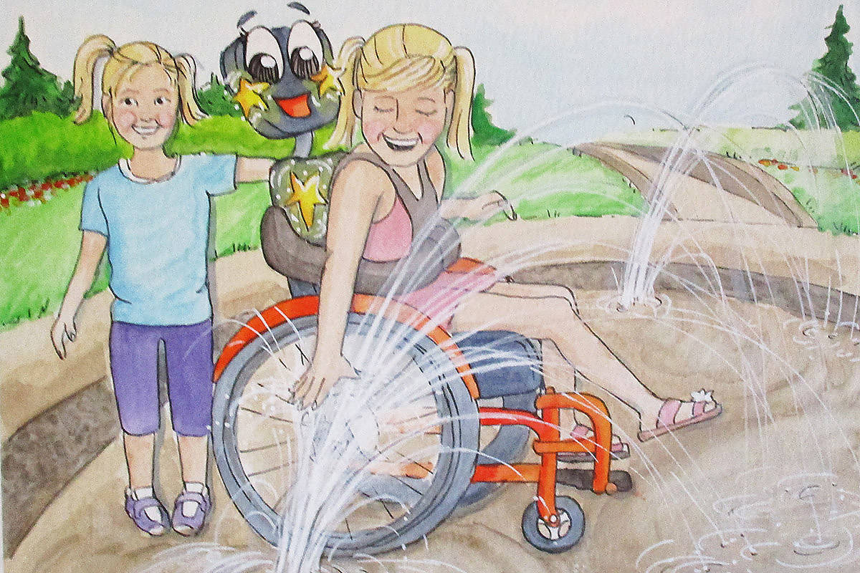
No House Work Day How to Observe
This day can be great excuse to give others and to yourself to stay away from sweeping, dusting, laundry, dishes and all the other items that fall into the housework category.
Spend this day on a book, TV show, have fun with your friends, and anything that you wanted to do for a long time

Slide 16
No House Work Day How to Observe
Quote For No House Work Day
“Housework is what a woman does that nobody notices unless she hasn’t done it.”
– Evan Esar

Slide 17
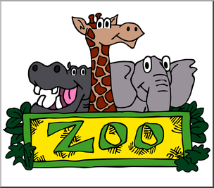
April 8, 2021
Thankful Thursday
Today's Lesson:
Part I: Zoo Lover Day
Part II: Leisure Time

Slide 18
Zoo Lover Day

Slide 19
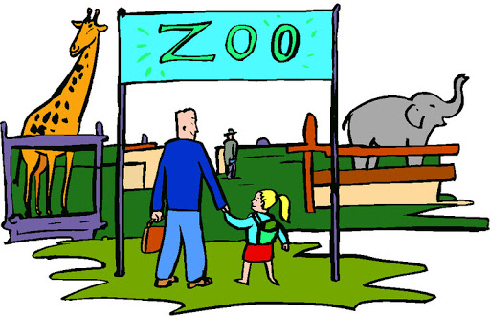
Zoo Lover Day What is this day?
National Zoo Lovers Day is celebrated on April 8 of every year. National Zoo Lovers Day is a day to visit the nearby zoo and make sure that be one be a part of one of the millions of people who visit them each year.
Hence National Zoo Lovers Day is a perfect day to see your favorite animals which swinging from trees to trees or splashing in the water.

Slide 20
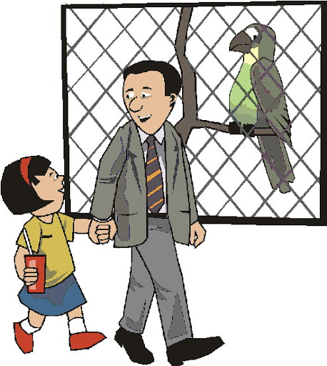
Zoo Lover Day History Behind this Day
The creator or inventor of National Zoo Lovers Day is still unknown. The first modern zoo was established in the beauty of Vienna, Austria with the order of Emperor Francis I in 1752.
It was created to viewing pleasure of the imperial family, but in 1765 it was extended to the public. In 1775, next zoo was opened in Madrid and Paris in 1795.
During that period there was an explosion of desire for such kind of zoo’s because they seem to represent the power of a nation to be able to have strange and exotic (unusual) animals from far-flung locales available for their peasantry viewing.

Slide 21
Zoo Lover Day-How to Observe
Celebrating the National Zoo Lovers Day is quite simple and easy to remember.
Just enjoy the day by visiting the local zoo with your family members or friends and watch your favourite animals.
For good memories, take photos of your favourite animal and share them on the social media’s by using the hashtag #ZooLoversDay.

Slide 22
Zoo Lover Day-How to Observe
“I am not into animal rights. I am only into animal welfare and health. I have been with the Morris Animal Foundation since the 70’s. We are a health organization. We fund campaign health studies for cats, dogs, lizards and wildlife. I have worked with the L.A. Zoo for about the same length of time. I get my animal fixes!”
– Betty White.

Slide 23
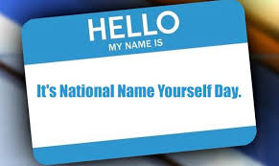
April 9, 2021
Happy Friday!
Today's Lesson:
Part I: National Name Yourself Day
Part II: The History of High Speed Rail and train

Slide 24
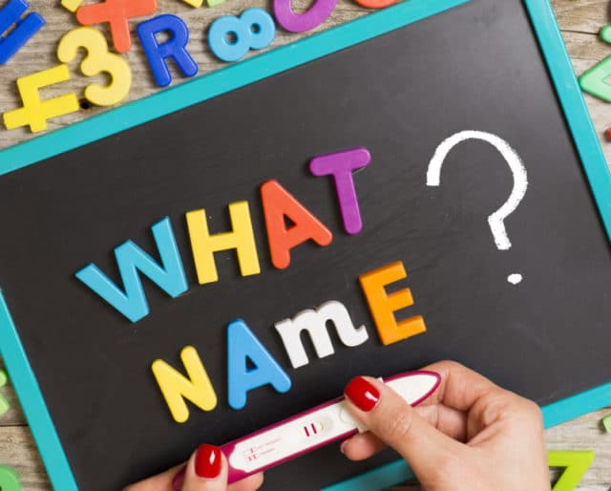
National Name Yourself Day

Slide 25
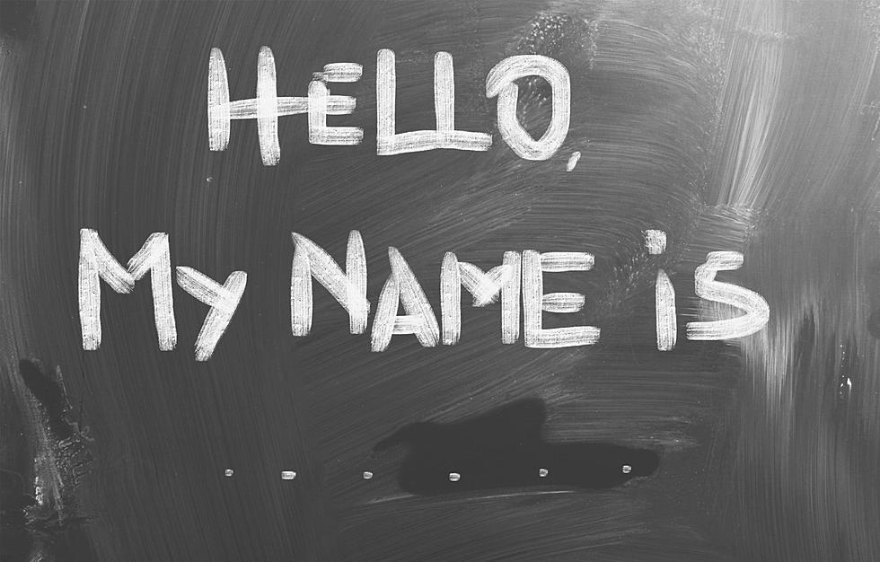
National Name Yourself Day What is this day?
National Name Yourself Day is a holiday when anyone can give themselves a different name.
It is a particularly fun holiday for those who do not like their names, but anyone can celebrate it.
According to some sources, one's name can only be changed for a day.
But, others say it can be changed permanently.

Slide 26
National Name Yourself Day History Behind this Day
People change both their first names and last names, do it legally and informally, and for a myriad of reasons.
On National Name Yourself Day, any of these routes to changing one's name may be used.
Although there are various rules about changing your name if you do it permanently, if you are just changing your name for the day, you can change it to whatever you want!

Slide 27
National Name Yourself Day
How to Observe
Change your name for the day or make the change permanent.
You could change your first, middle, or last name, or all three.
If you wish to make your change permanent, check to see what your state's name change laws are, so you know the best way to proceed.
Some companies such as Hitchswitch, I'm a Mrs., and LegalZoom can help streamline the name-changing process.

Slide 28
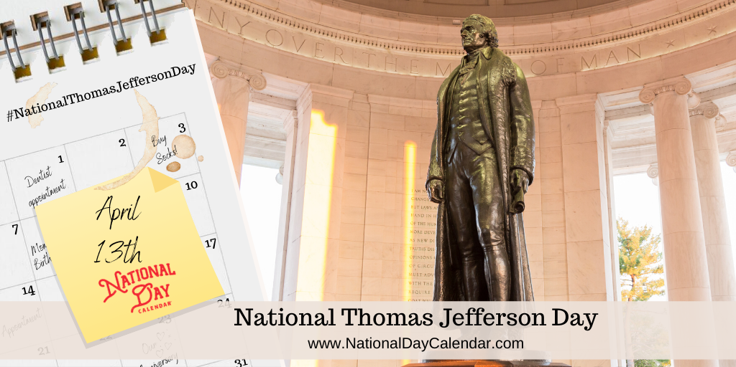
April 13, 2021
Terrific Tuesday
Today's Lesson:
Thomas Jefferson Day

Slide 29
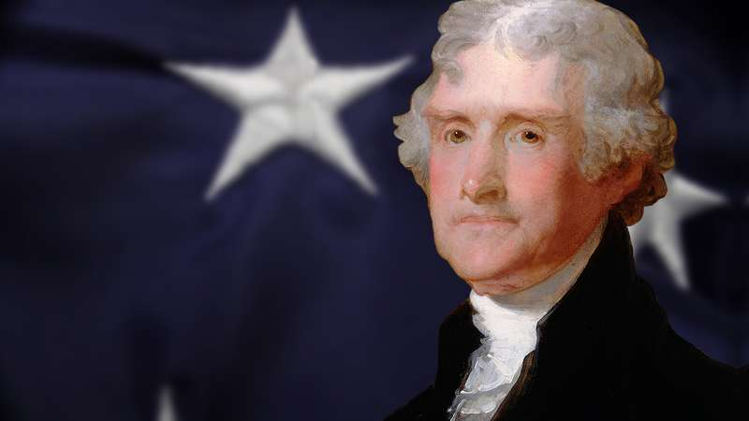
Thomas Jefferson Day

Slide 30
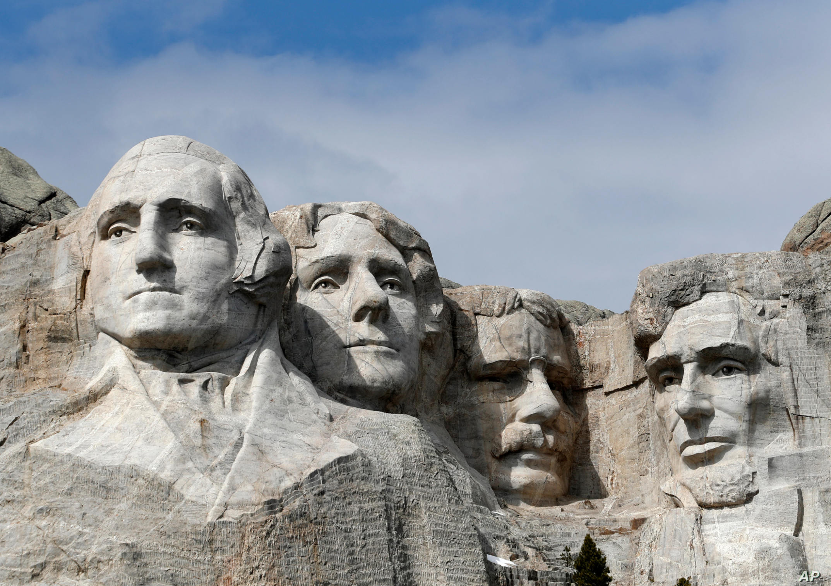
Mount Rushmore with the sculpted heads of George Washington, Thomas Jefferson, Theodore Roosevelt and Abraham Lincoln (left to right)

Slide 31
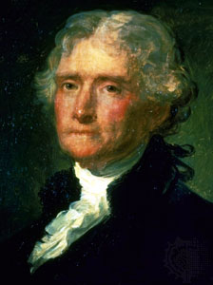
Thomas Jefferson Day What is this day?
Thomas Jefferson Day is a legal observance, but it is not a public holiday.
A joint resolution approved on August 16, 1937, authorized the President of the United States to proclaim (‘prokleim) April 13 as "Thomas Jefferson's Birthday" each year.
The following year, President Franklin D. Roosevelt issued Presidential Proclamation 2276 to designate the day.
Subsequent presidents have made similar proclamations. In Alabama, Thomas Jefferson's birthday is officially celebrated on Presidents' Day, along with George Washington's.

Slide 32
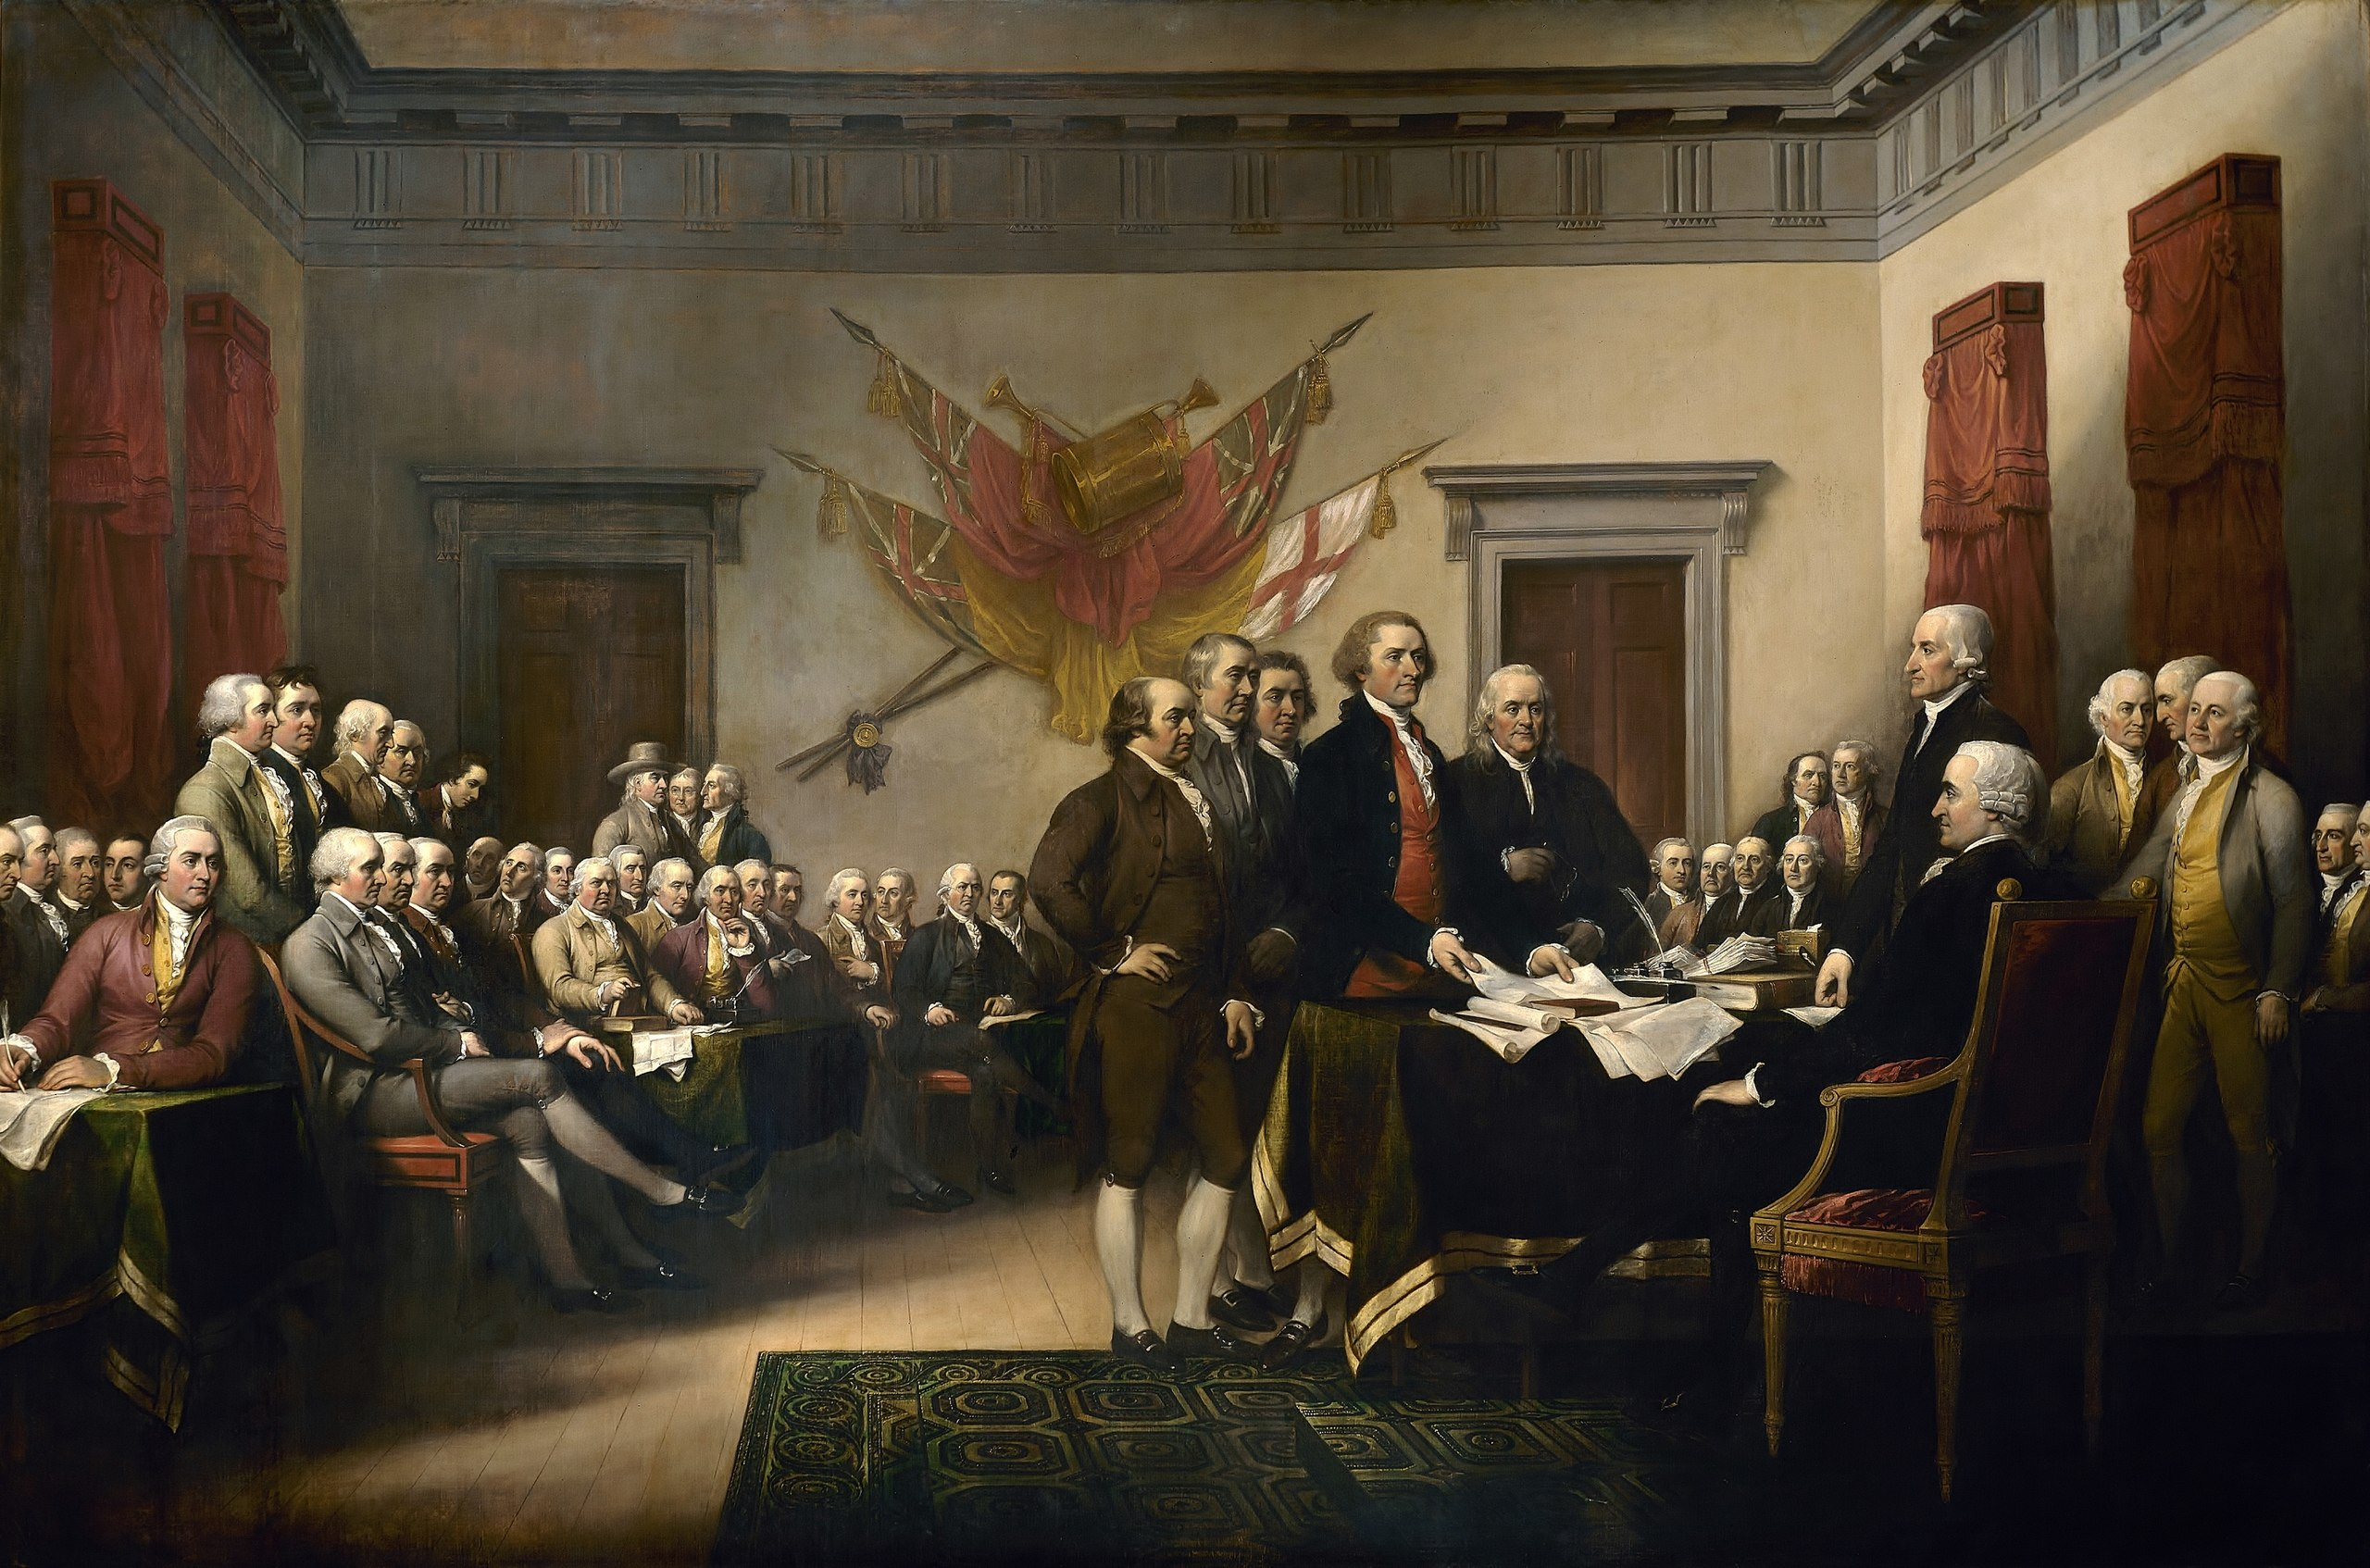
Thomas Jefferson (April 13, 1743 – July 4, 1826) was an American statesman, diplomat, lawyer, architect, philosopher, and Founding Father who served as the third president of the United States from 1801 to 1809.
He had previously served as the second vice president of the United States under John Adams between 1797 and 1801.
The principal author of the Declaration of Independence, Jefferson was a proponent of democracy, republicanism, and individual rights, motivating American colonists to break from the Kingdom of Great Britain and form a new nation; he produced formative documents and decisions at both the state and national levels.

Slide 33
He served as the second Governor of Virginia from 1779 to 1781, during the American Revolutionary War.
In 1785, Jefferson was appointed the United States Minister to France, and subsequently, the nation's first Secretary of State under President George Washington from 1790 to 1793.

Slide 34
Starting in 1803, Jefferson promoted a western expansionist policy, organizing the Louisiana Purchase which doubled the nation's land area.
To make room for settlement, Jefferson began a controversial process of Indian tribal removal from the newly acquired territory. As a result of peace negotiations with France, his administration reduced military forces.
Jefferson was reelected in 1804. His second term was beset with difficulties at home, including the trial of former vice president Aaron (‘eilanbur) Burr. In 1807, American foreign trade was diminished when Jefferson implemented the Embargo (em’ba:go) Act in response to British threats to U.S. shipping. The same year, Jefferson signed the Act Prohibiting Importation of Slaves.

Slide 35
Louisiana Purchase
The Louisiana Purchase (French: Vente de la Louisiane 'Sale of Louisiana') was the acquisition of the territory of Louisiana by the United States from France in 1803.
In return for fifteen million dollars, or approximately eighteen dollars per square mile, the United States nominally acquired a total of 828,000 sq mi.
However, France only controlled a small fraction of this area, most of it inhabited by American Indians; for the majority of the area, what the United States bought was the "preemptive" right to obtain Indian lands by treaty or by conquest, to the exclusion of other colonial (‘klonial) powers..

Slide 36
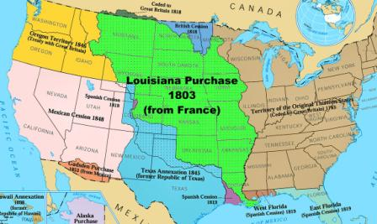
"Architecture is my delight, and putting up, and pulling down, one of my favorite amusements."

Slide 37
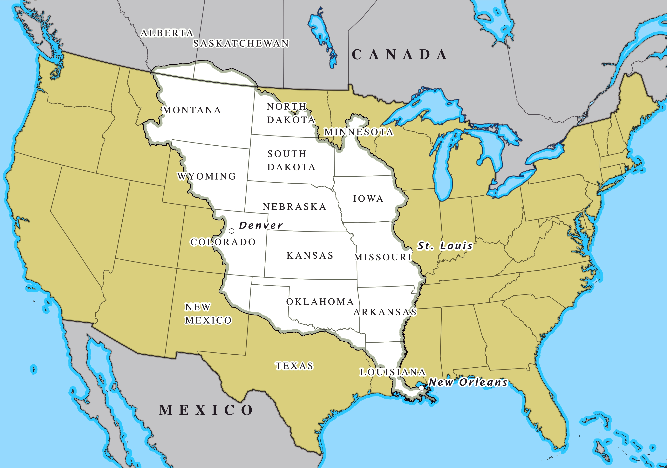
"Architecture is my delight, and putting up, and pulling down, one of my favorite amusements."

Slide 38
Jefferson, while primarily a planter, lawyer and politician, mastered many disciplines, which ranged from surveying and mathematics to horticulture and mechanics. He was an architect in the classical tradition.
Jefferson's keen interest in religion and philosophy led to his presidency of the American Philosophical Society; he shunned organized religion but was influenced by Christianity (Kristi’aniti), and deism. Jefferson knew several languages.

Slide 39
Jefferson’s marriage
On January 1, 1772, Jefferson married his third cousin Martha Wayles Skelton, the 23-year-old widow of Bathurst Skelton, and she moved into the South Pavilion. She was a frequent hostess for Jefferson and managed the large household.
Biographer Dumas Malone described the marriage as the happiest period of Jefferson's life. Martha read widely, did fine needlework, and was a skilled pianist; Jefferson often accompanied her on the violin or cello ( ‘chelo). During their ten years of marriage, Martha bore six children.

Slide 40
After retiring from public office, Jefferson founded the University of Virginia.
Jefferson and his colleague John Adams both died on Independence Day, July 4, 1826, the 50th anniversary of the adoption of the Declaration of Independence.
Presidential scholars and historians generally praise Jefferson's public achievements, including his advocacy (‘avokosi) of religious freedom and tolerance in Virginia.

Slide 41
Thomas Jefferson Day
Here are some ideas on how to celebrate the day:
Visit Monticello. As part of your visit, you could stop at the visitor center, the Robert H.
Smith International Center for Jefferson Studies, The Thomas Jefferson Center for Historic (his’t):rik) Plants, and at Jefferson's grave.
Find the historical marker at Shadwell.
View the Declaration of Independence at the National Archives Museum.

Slide 42
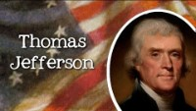
"Architecture is my delight, and putting up, and pulling down, one of my favorite amusements."

Slide 43
"Architecture is my delight, and putting up, and pulling down, one of my favorite amusements."

Slide 44
"Architecture is my delight, and putting up, and pulling down, one of my favorite amusements."

Slide 45
Thomas Jefferson Day History Behind this Day
Jefferson served two terms as president and was in office from 1801 to 1809. During his first term, in 1803, he helped orchestrate the Louisiana Purchase, in which the size of the United States doubled with the purchase of land for $15 million from France. Jefferson sent Meriwether Lewis and William Clark on an expedition, known as the Corps of Discovery, to explore the new land.

Slide 46
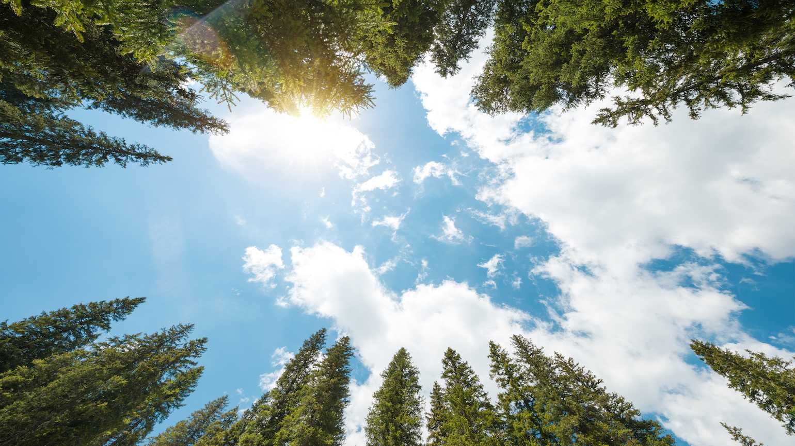
April 14, 2021
Wonderful Wednesday
Today's Lesson:
Part I: Look Up At the Sky Day
Part II:
How does bullet train look like inside?
The history of high speed rail & bullet train
Exercises
Video: The first high speed rail & bullet train in Japan

Slide 47
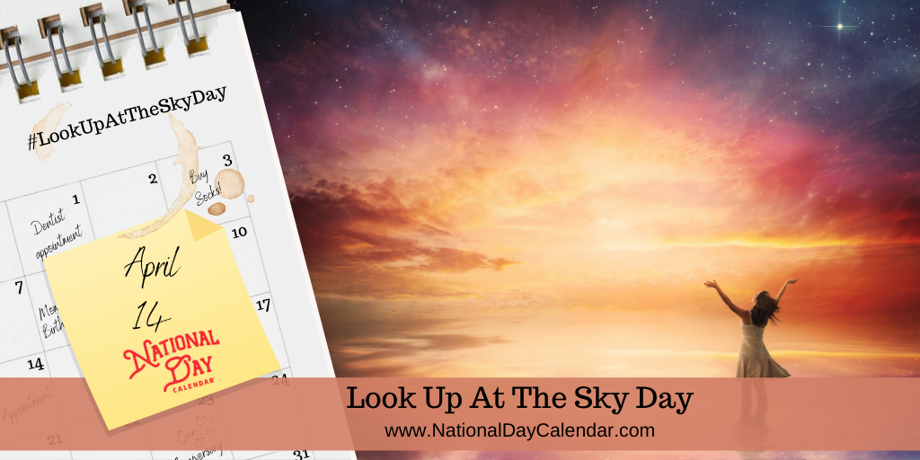
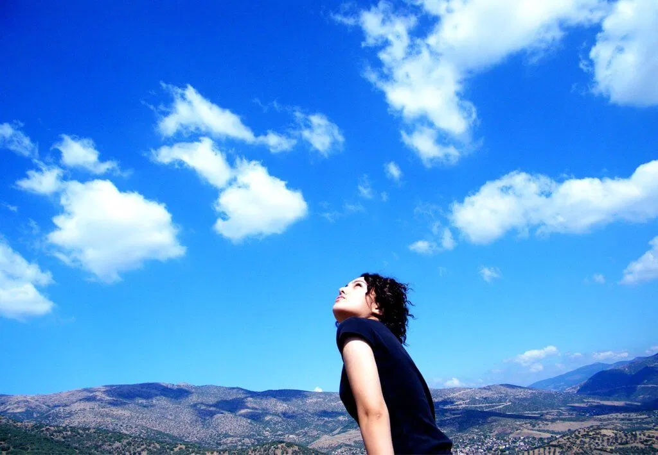
Look Up At the Sky Day

Slide 48
Look Up the Sky Day What is this day?
National Look Up At The Sky Day is observed on April 14 of every year.
National Look Up At The Sky Day encourages everyone to spend the time to look up at that beautiful sky which we should have probably done when we were kids.
In the daytime, you may find some airplanes, various patterns of the clouds, the flock of birds flying around, the shining sun and during the night you can spot some dazzling stars and moon..

Slide 49
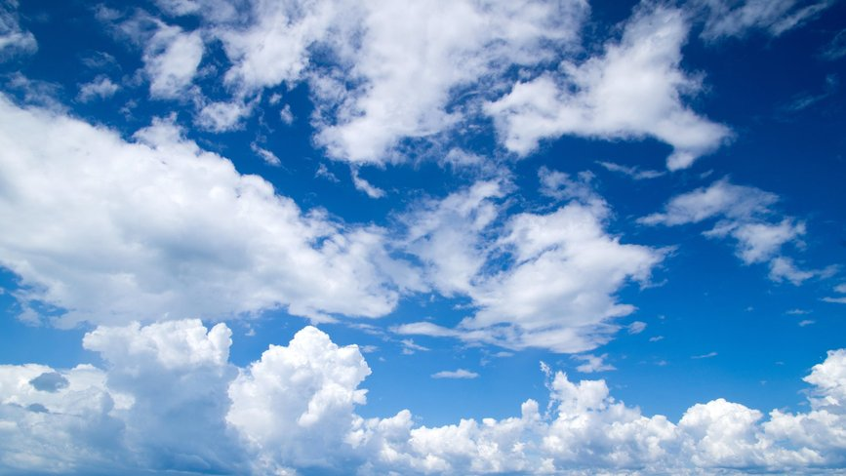
Look Up At the Sky Day History Behind this Day
The origin and the creator of the National Look Up At The Sky Day remain unknown. This day is believed to be celebrated for years.
The creator has created this day to make people come outdoor and enjoy nature. This day is important to be honoured because all of us enjoy the blue sky. to appreciate little things in our hectic life.

Slide 50
Look Up the Sky Day How to Observe
As the environment is free and found in abundance, it is always taken for granted to be enjoyed and thanked for. So take some time in celebrating the small things in life.
It may have been created to make people think about the emptiness in the sky and to encourage everyone to think beyond the air. Appreciate little things in our hectic (excited) life.

Slide 51
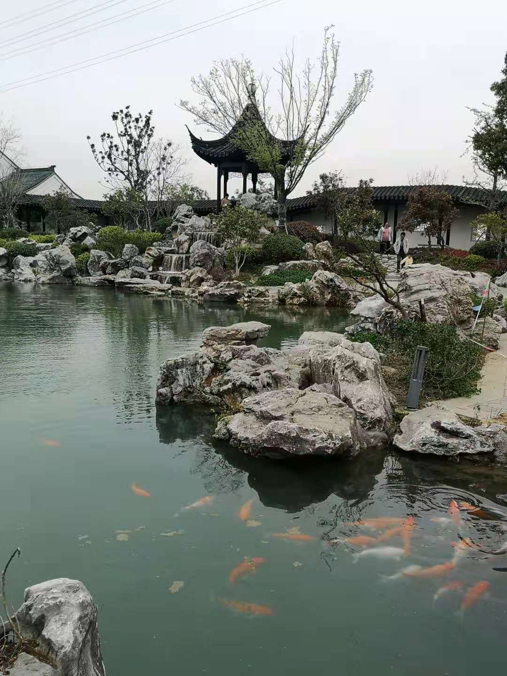

Slide 52
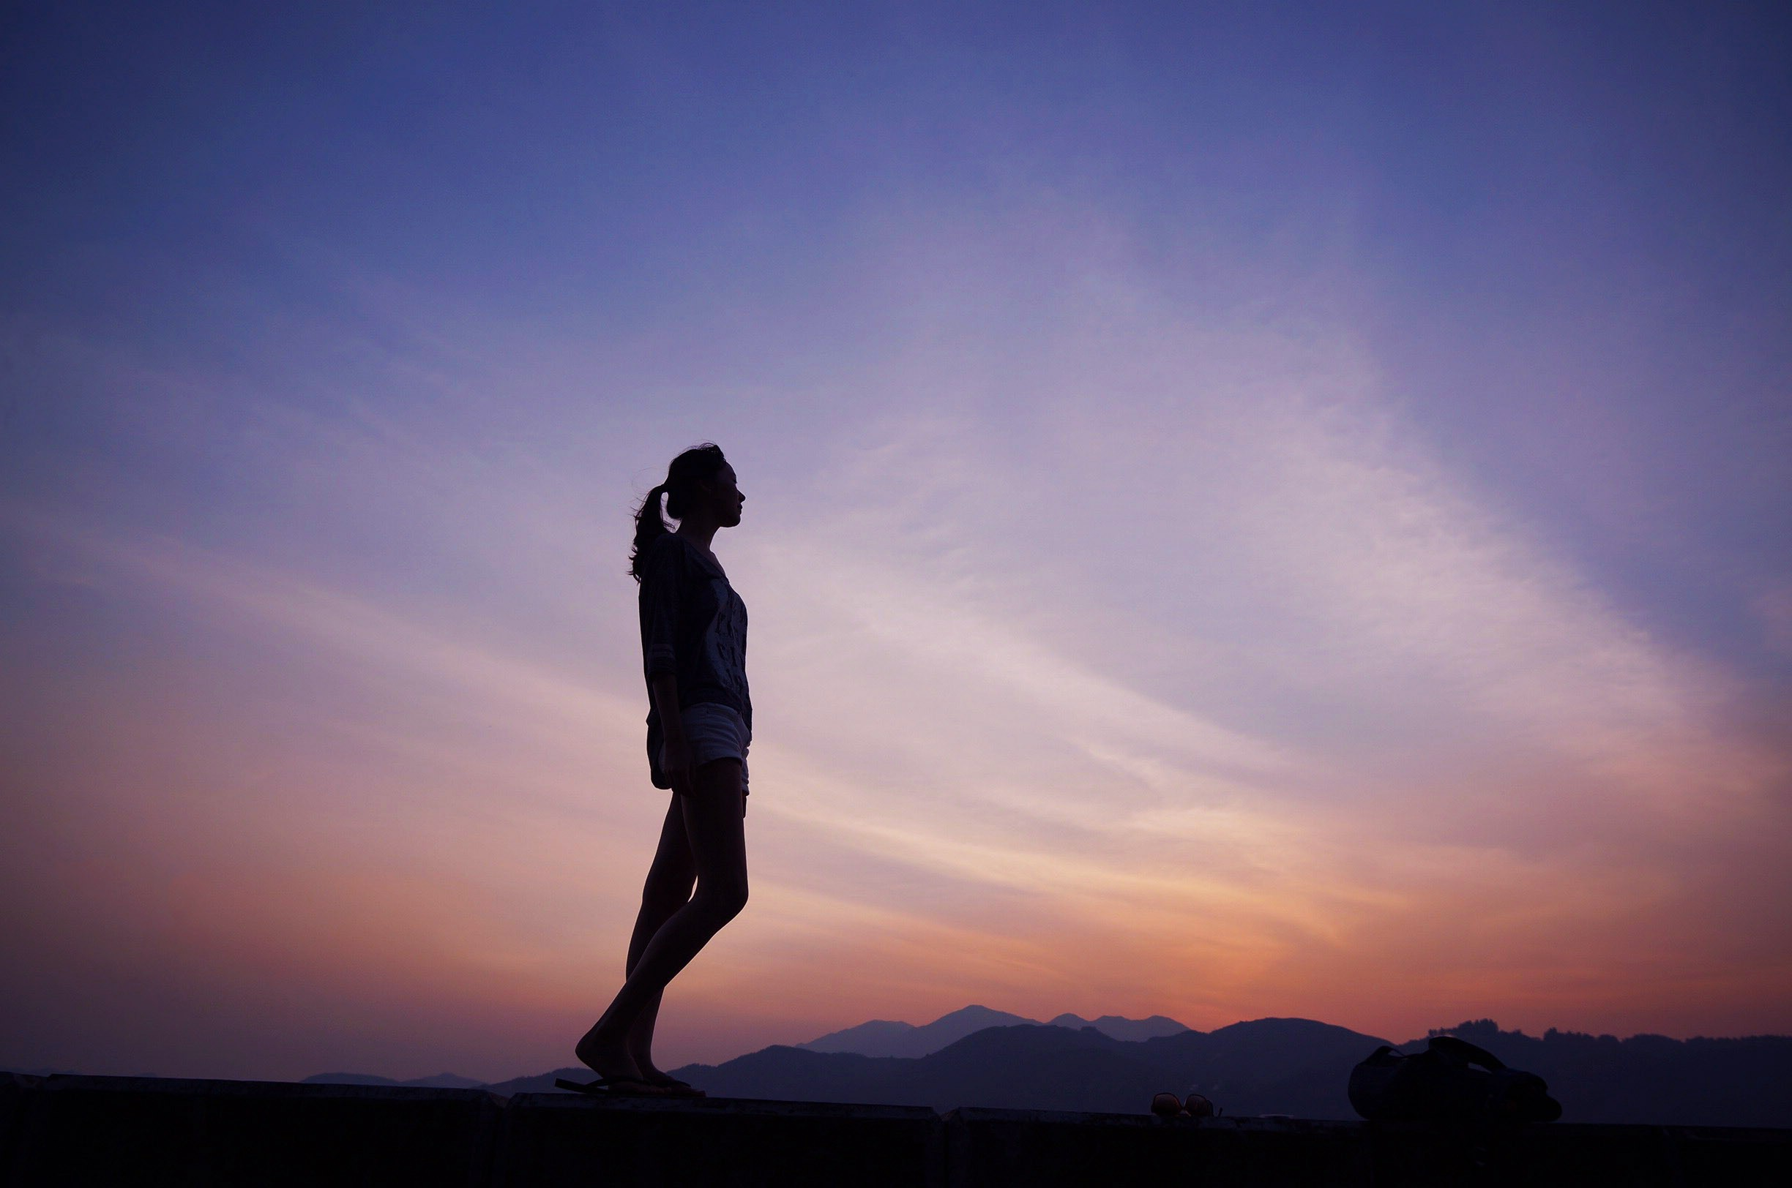
Look Up the Sky Day History Behind this Day
“Look at the sky. We are not alone. The whole universe is friendly to us and conspires only to give the best to those who dream and work.”- A. P. J. Abdul Kalam

Slide 53

April 15, 2021
Thankful Thursday
Today's Lesson:
Part I: Take A Wild Guess Day
Part II: History of high speed rail & bullet train

Slide 54
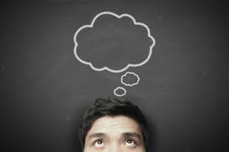
Take A Wild Guess Day

Slide 55
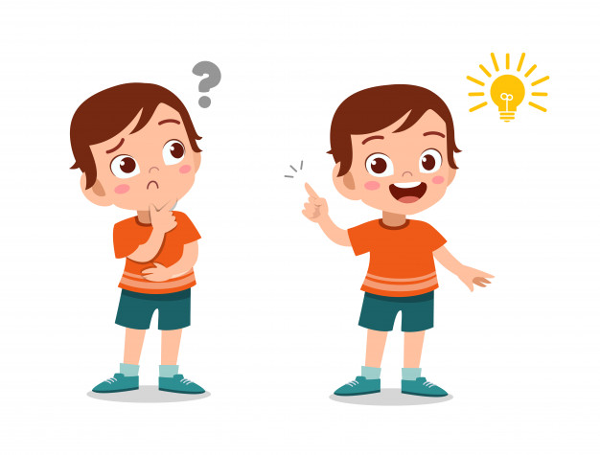
Take A Wild Guess Day What is this day?
National Take A Wild Guess Day is observed on April 15 of every year.
Take A Wild Guess honours and celebrates all kinds of hunches, intuitions, divinations, predictions, and sixth senses.
Take A Wild Guess Day is a day you may want to guess how many coins are in the tube and how many jellybeans are in the jar etc (e’setrerler). It is a day full of guesses and hunches.

Slide 56
Take A Wild Guess Day History Behind this Day
National Take A Wild Guess Day was created by Jim Barber.
The originator of this day, Jim Barber made a successful guess that Take A Wild Guess Day would be a hit, and he proved to be correct as Take A Wild Guess Day is observed every year successfully, and many people have joined in celebrating this day.

Slide 57
Take A Wild Guess Day How to Observe
We all make a lot of guesses throughout our life. Sometimes these assumptions and guesses can bring us great pleasure or motivate us to take chances.
The main aim of this day is to turn the spotlight on intuitions, hunches, extraordinary leaps of assumption and outright guessings.

Slide 58
Take A Wild Guess Day
“I like to keep people guessing.”
– Amanda Seyfried

Slide 59
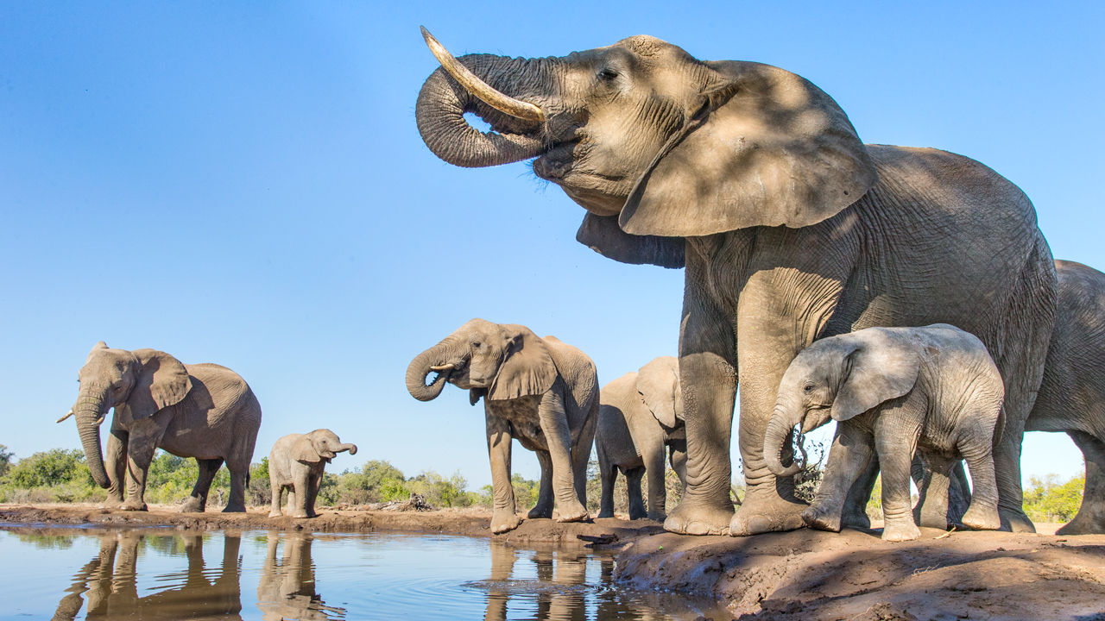
April 16, 2021
Happy Friday
Today's Lesson:
Part I: Save the Elephant Day
Part II: Benefits of recreation participation in leisure time

Slide 60
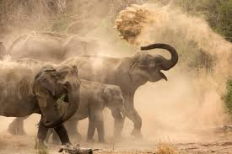
Save the Elephant Day

Slide 61
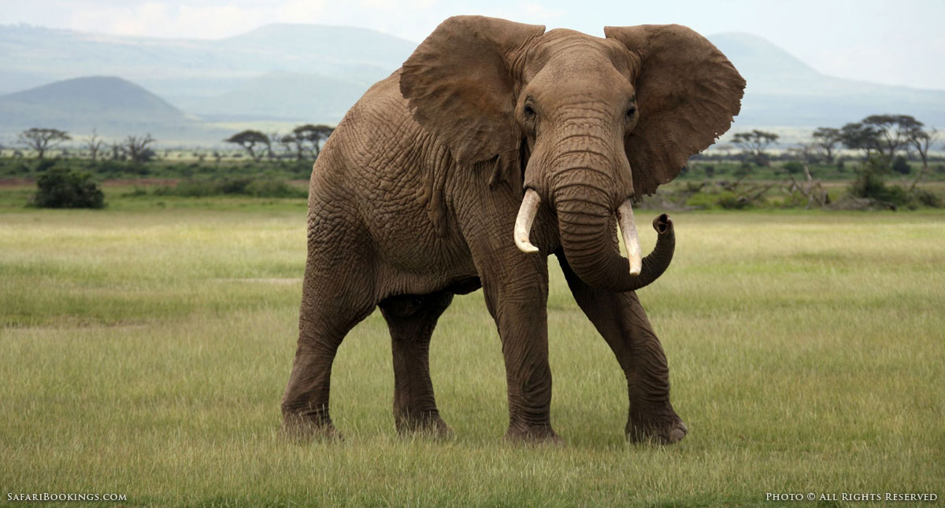
Save the Elephant Day What is this day?
Save the Elephant Day is celebrated on April 16 of every year. Save the Elephants Day is created to raise awareness about the dangers elephants face and various difficulties they have to overcome to live.
By spreading awareness the general people can understand the significance and consequences of their actions, or inactions on the future of elephants.
The two main problems to elephants are their habitat loss and ivory (‘iverri) trade, both of these threats are due to humans.

Slide 62
Save the Elephant Day History Behind this Day
Save the Elephant Day is established by the Elephant Reintroduction Foundation, in Thailand, together with Patricia Sims, a Canadian film-maker.
The launch of this worldwide initiative (i’nisitiv) in the year 2012 saw the release of the “Return to the Forest”, a documentary film described by Star Trek ce’lebrity William Shatner.

Slide 63
Save the Elephant Day History Behind this Day
Elephants are the wildlife idols and the sad thing is that these lovely giants are in great crisis.
Save the Elephants Day is the best opportunity to show our care and love for these wildlife icons and spread awareness about the threats to their future in Asia and Africa, ranging from ivory(‘iverri) traders and loss of habitat.

Slide 64
Save the Elephant Day
A quote for today:
“Nature’s great masterpiece, an elephant; the only harmless great thing.”
– John Donne

Slide 65
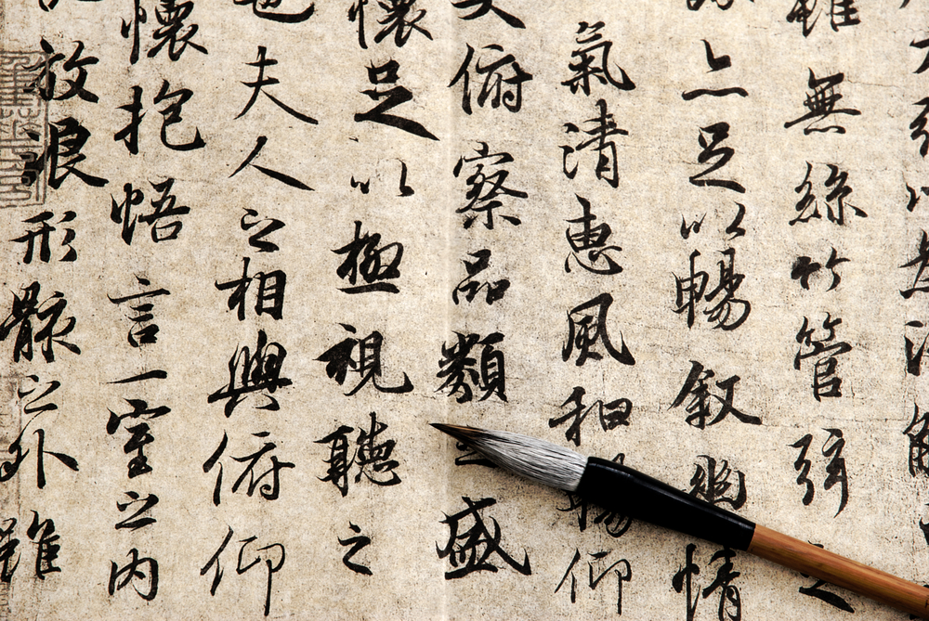
April 20, 2021
Terrific Tuesday
Today's Lesson:
Part I: Chinese Language Day
Part II: High speed rails around the world

Slide 66
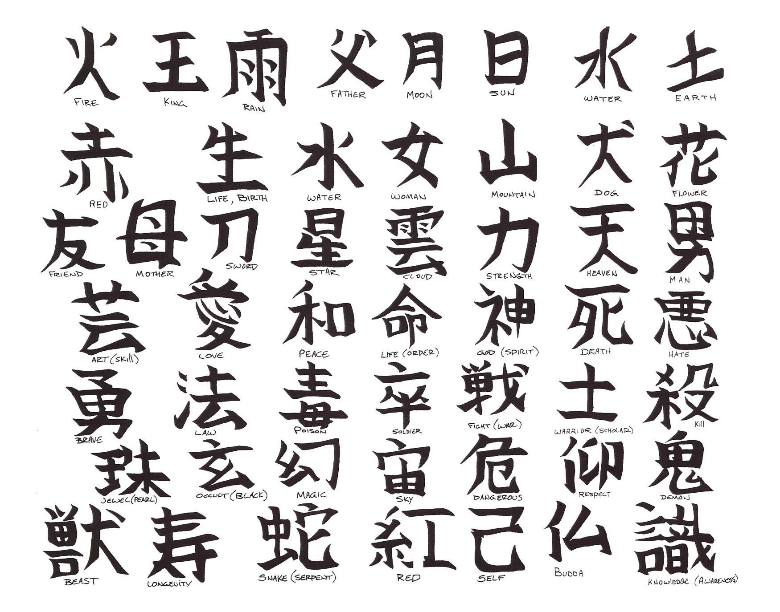
Chinese Language Day

Slide 67

Chinese Language Day What is this day?
Chinese Language Day is observed on April 20 of every year. It was established by the United Nations Educational, Scientific and Cultural Organization (UNESCO).
The UN and its affiliate (a’filiert) organizations use this day to encourage multiculturalism and cultural diversity by displaying the history and literary culture of all six of its official language.
The Six official languages of UN are English, Arabic (‘arerbik), French, Spanish, Chinese, and Russian. Each language has a day dedicated to it.

Slide 68
Chinese Language Day History Behind this Day
The first Chinese Language Day was observed on 12th November 2010.
Then the date was moved to 20th April In the year 2011 to honor Cang Jie, a legendary figure in ancient China. About 5 thousand years ago, he was assumed to have invented the Chinese characters.
Myths say that Cang Jie had four eyes and four pupils and when he created the Chinese characters, gods and ghosts cried, and the sky rained millets.

Slide 69
Chinese Language Day History Behind this Day
From that time, Chinese celebrate this day as Guyu or Rain of Millet in ‘tribute to Cangjie.
As per Gregorian (gre’g):rian) calendar date, Guyu is celebrated on or around 20th April.
Chinese Language Day is not a public holiday but just an observance.
This day is created mainly to highlight the contribution of Chinese-language, poetry, and literature in world culture.

Slide 70
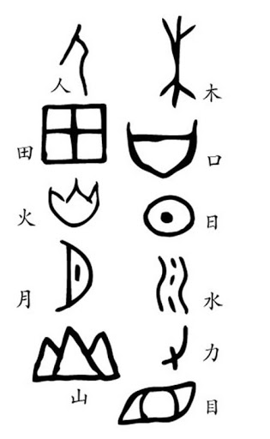
Chinese characters

Slide 71
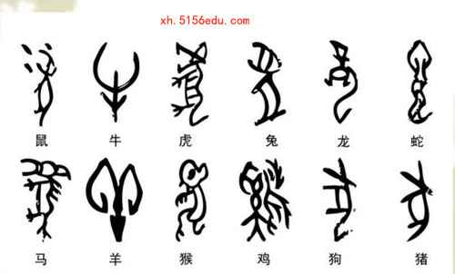

Slide 72
Quote for today
“Give a man a fish and you feed him for a day; teach a man to fish and he’ll eat forever”.
– Chinese Proverb.

Slide 73
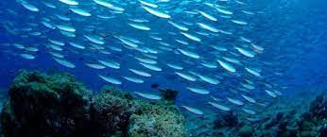
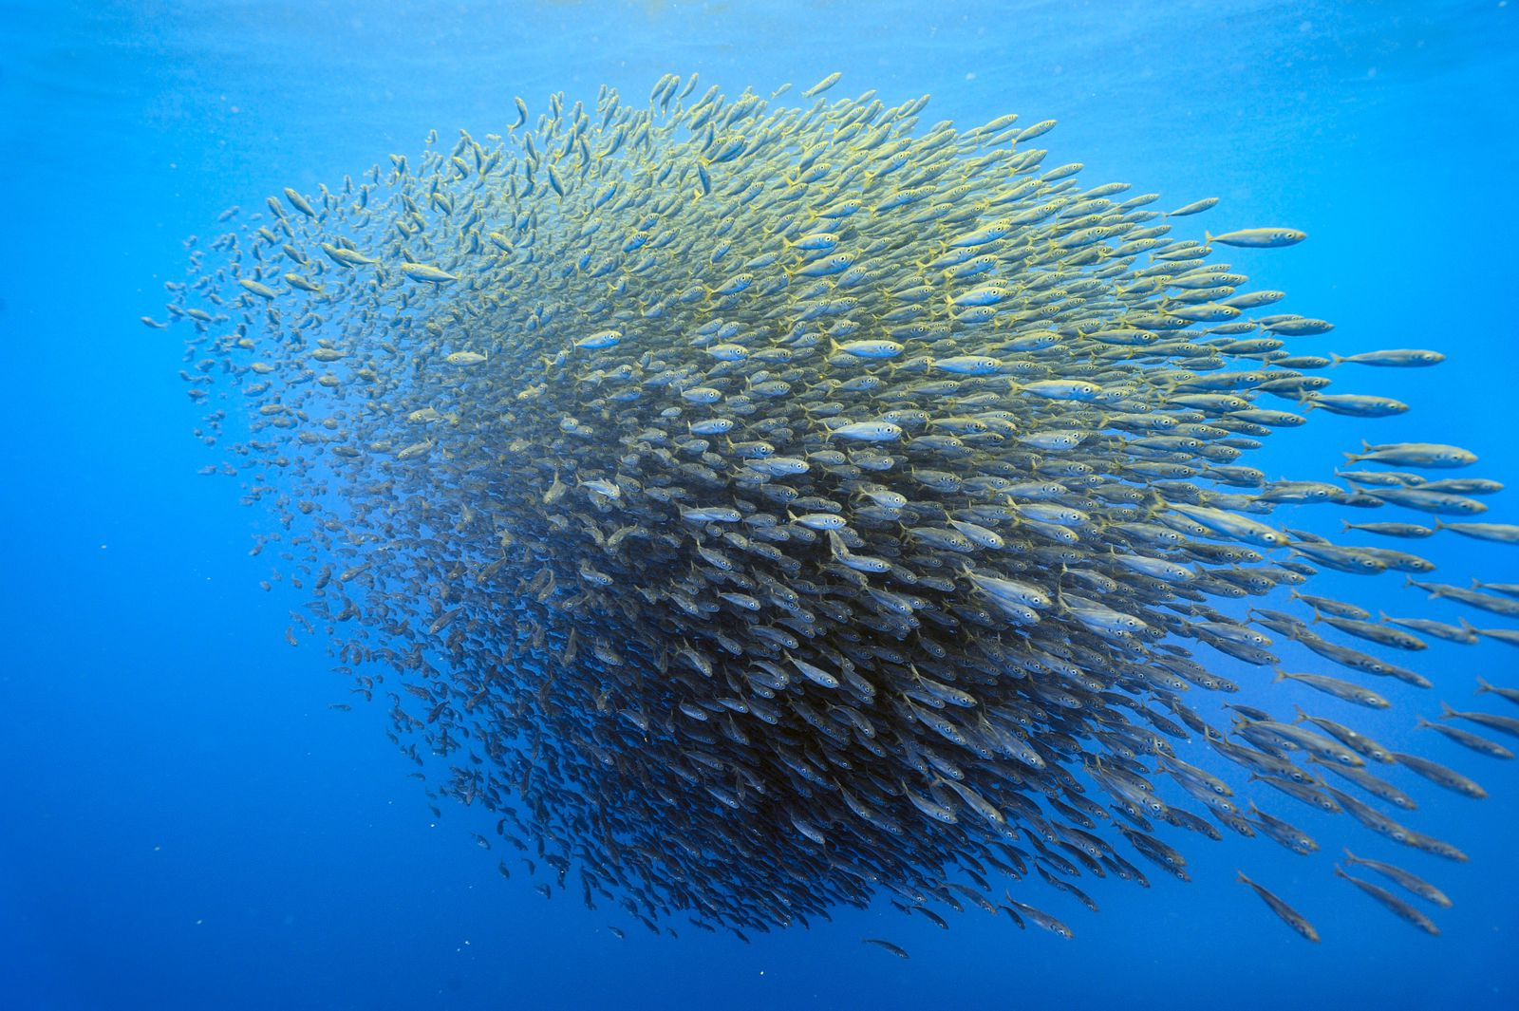
April 21, 2021
Wednesday
Today's Lesson:
Part I: World Fish Migration Day
Part II: The benefits of leisure time

Slide 74

World Fish Migration Day

Slide 75
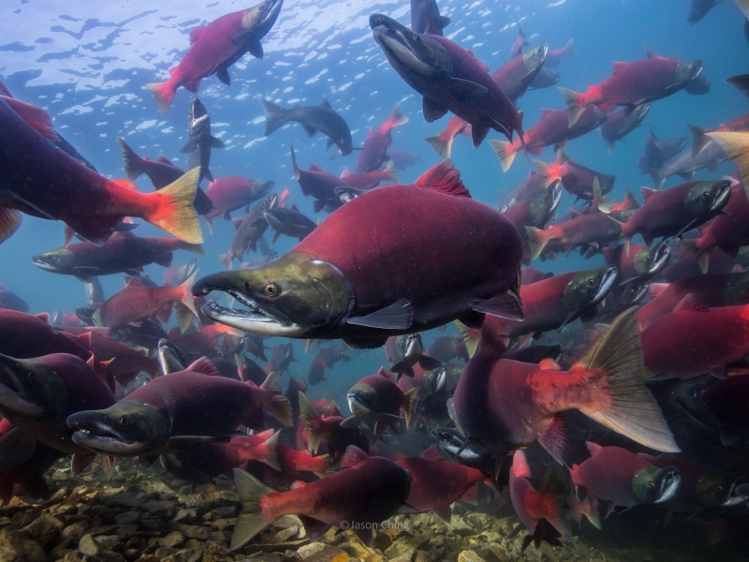
World Fish Migration Day What is this day?
World Fish Migration Day is observed on 21st April of every year. World Fish Migration Day or WFMD is a one-day global-local celebration that is observed every year to raise awareness on the significance of restored river connections and migratory (‘migrerterri) fish.
Many ‘migratory (‘migrerterri) fishes make up an essential link in the food chain, and they play a very vital role in rich, productive, and healthy river systems.
More than that these migratory fishes provide a significant food supply and livelihood for more than millions of people around the globe.

Slide 76
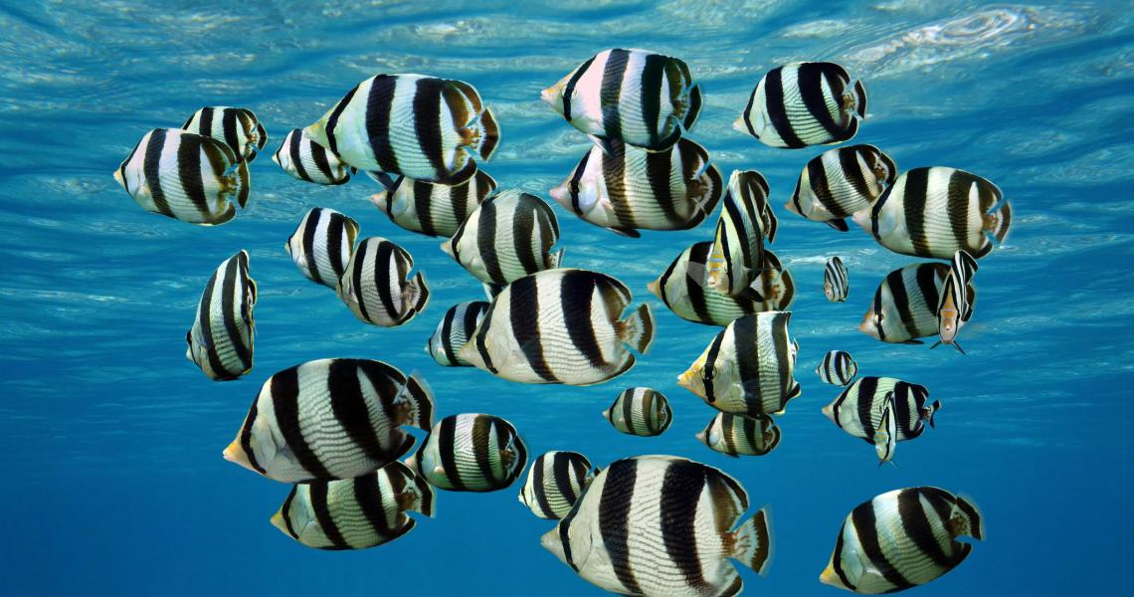
World Fish Migration Day History Behind this Day
Migratory fishes are very severely threatened. The main reason for this is human-made barriers like dams, sluices (‘slu:sis), and weirs which disturb the natural rivers networks and prevent fish migration.
Many fish species want to migrate to reproduce and to complete their regular life cycles. So the main aim of this day is to enhance the understanding of people about migratory fish, and the need for open rivers.

Slide 77
World Fish Migration Day How to Observe
The next step is to raise awareness among people around the world about the necessary measures we have to take to avoid this problem and to safeguard and conserve these migratory fish species.

Slide 78
World Fish Migration Day
.
“What is a fish without a river? What is a bird without a tree to nest in? What is an Endangered Species Act without any enforcement mechanism to ensure their habitat is protected? It is nothing.”
– Jay Inslee.

Slide 79
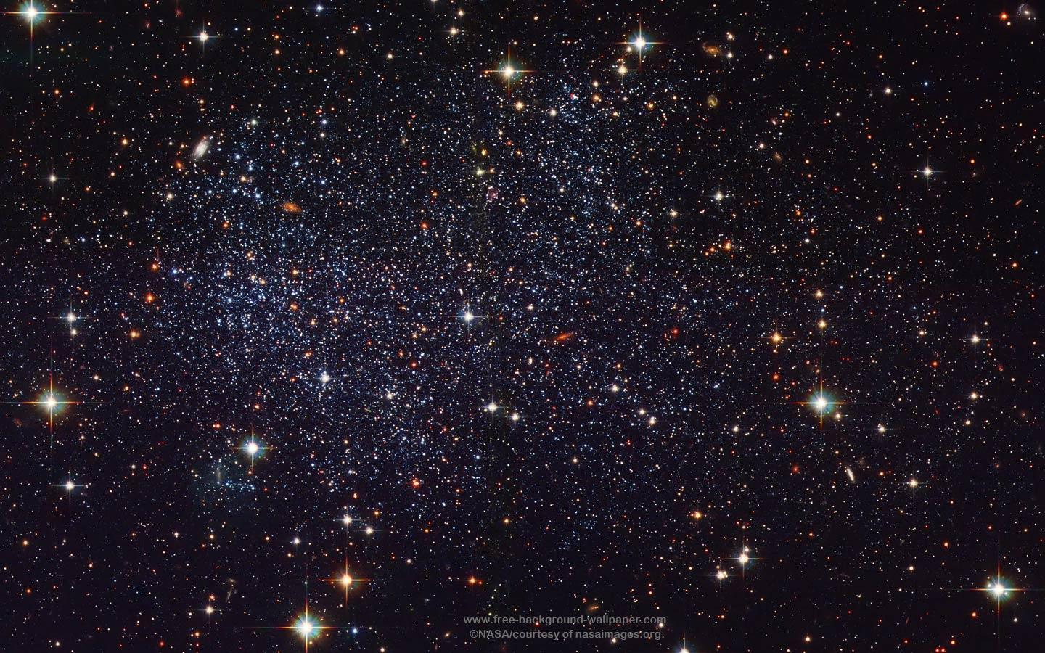
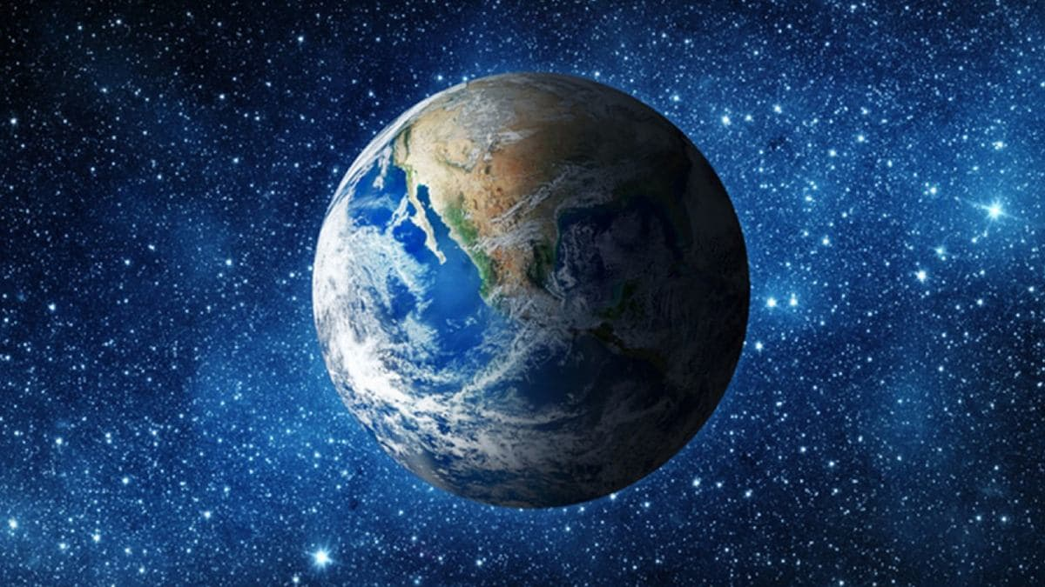
April 22, 2021
Thankful Thursday
Today's Lesson:
Part I: International Earth Day
Part II: High Speed Rail in France

Slide 80

International Earth Day

Slide 81
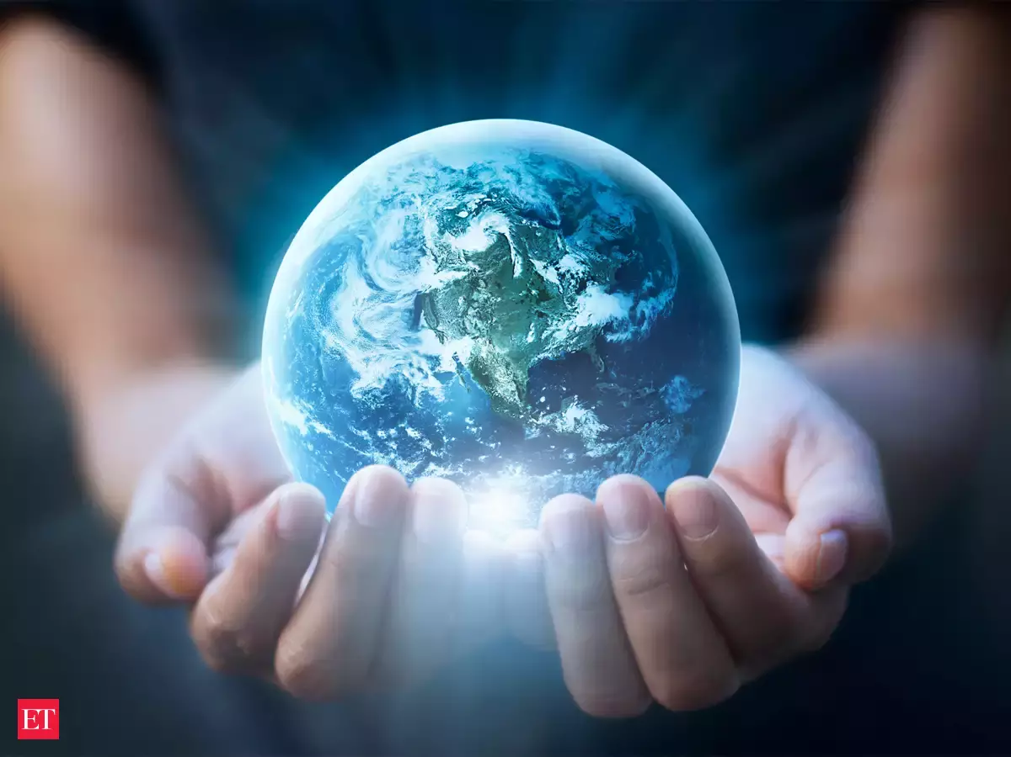
International Earth Day What is this day?
International Earth Day is observed on April 22 of every year. International Earth Day is celebrated around the world to demonstrate the support for environmental protection.
The Earth Day Network globally coordinates this day, and it is observed in nearly 193 countries. The main aim of the day is to raise awareness about environmental issues and to show our appreciation for the improvement of the natural environment

Slide 82
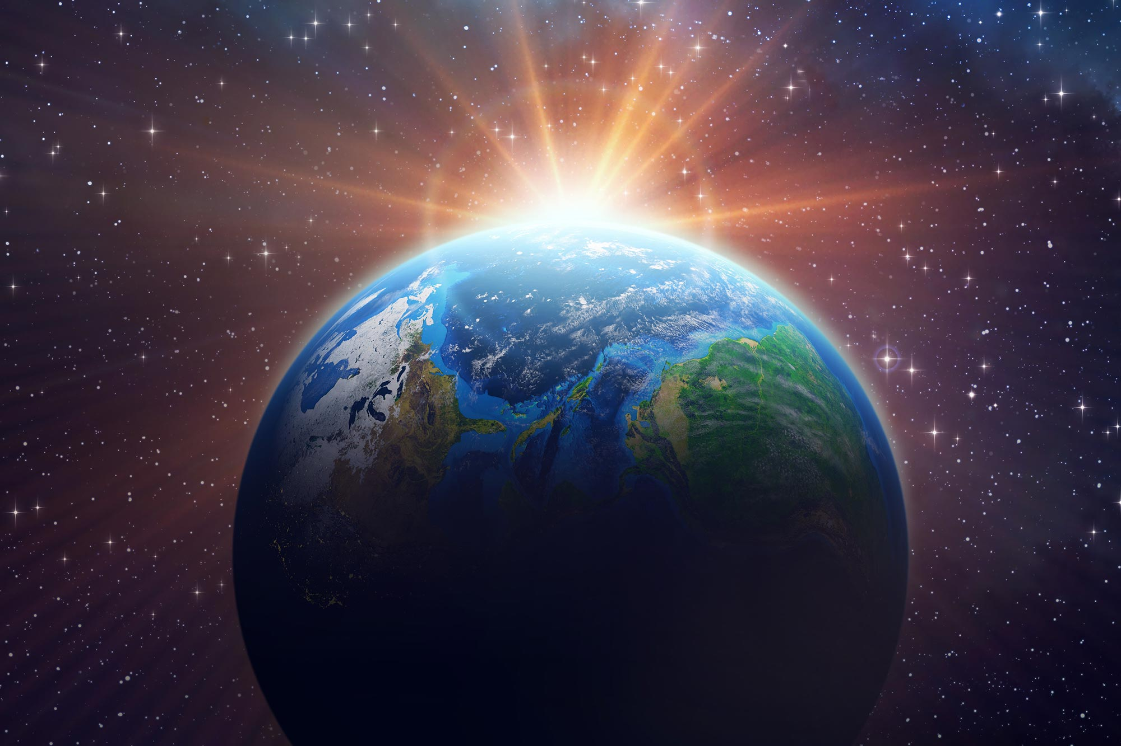
International Earth Day History Behind this Day
In 1940, Senator Nelson organized the International Earth Day on April 22 to promote ecology and to increase the awareness about the increasing problems of water, air and the soil pollution.
In some parts of the world, International Mother Earth Day is observed around the time of March equinox.

Slide 83
International Earth Day
The symbol used to describe the day contains an image of planet earth; a flower or leaves de’picting the growth, and the colours like green, blue and brown will be used.
Let’s celebrate the Day by spreading awareness among the people about the protection of our natural environment.

Slide 84
Earth Day2021 Celebration around the world

Slide 85
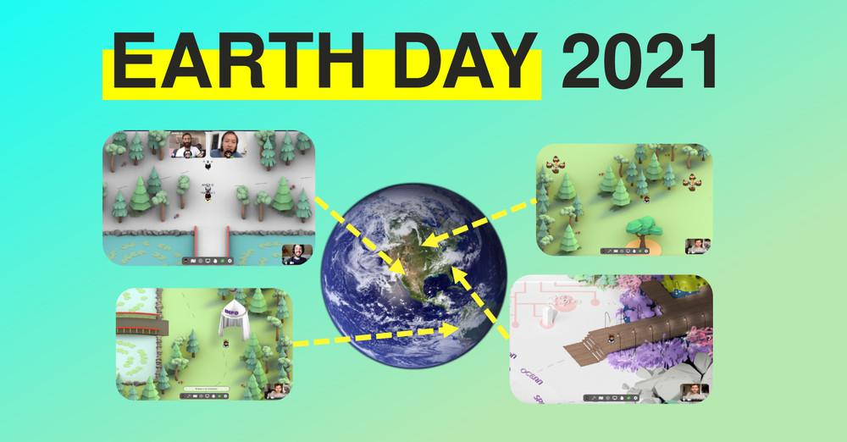
In Geneva, Switzerland, the International School of Geneva is hosting a “green sale” and an organic food sale to raise money to plant trees on the school grounds. There will also be activities like recycling games and environmental arts and crafts.

Slide 86

In Dublin, Earth Day Network partner ECO-UNESCO is running its annual ECO-Explorer Camp for kids from April 22nd to April 25th at the Greenhouse in Dublin City Center. Campers, or ECO-Explorers, ages 5-12 will explore the local urban ecology, take weather measurements, investigate city wildlife and discover Dublin’s green spaces like never before. The ECO-Explorers will also participate in the designing of future Green Cities using drawings and 3D art.

Slide 87

Earth day in America
Berkeley, California
Celebrate healthy and sustainable living with Berkeley’s 7th Annual Earth Day on April 22, 2021.
Compassionate Living, a non-profit organization based in Sonoma County, promotes sustainable food, eco-friendly product vendors and opportunities for activism.
Also feed your brain with educational talks from conversation experts, nutritionists, activists and more.

Slide 88
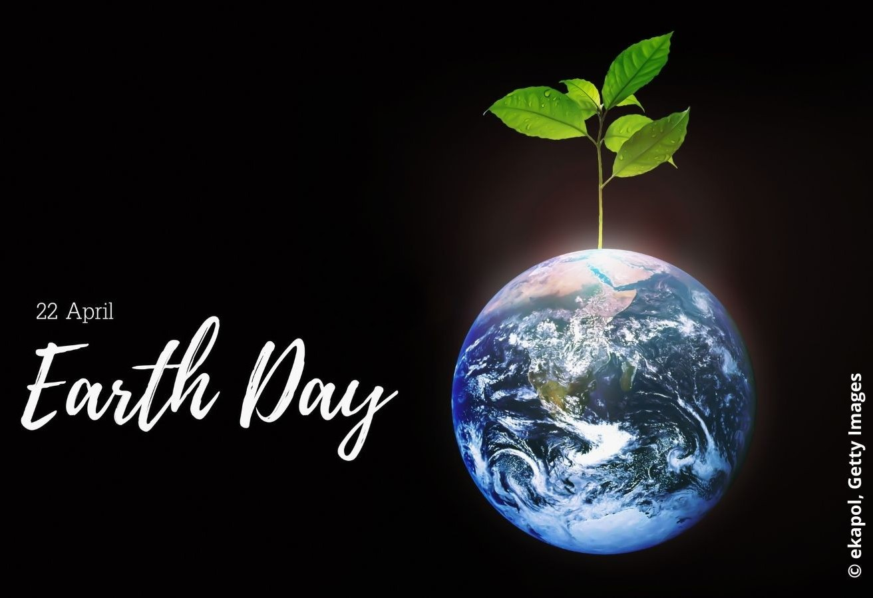
U.S. NASA, In celebration of Earth Day 2021, NASA is hosting a live-streaming event from April 21- 24 focusing on sustainability, climate change, and the world's ecosystems.
This event will feature live conversations with astronauts and presentations by NASA scientists. Registration is free and open to the public.

Slide 89


Slide 90
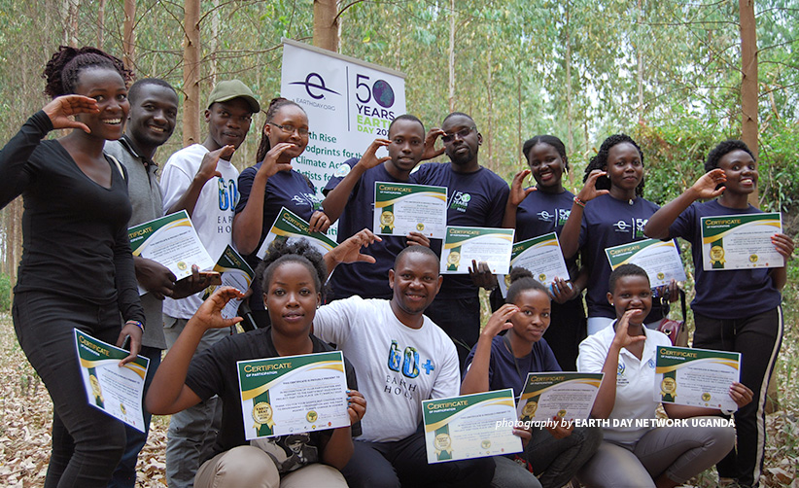
Elebrate Earth Day in Africa
Mugisha is one of nine Earth Day Network organizers in nine African countries supported by African Wildlife Foundation to mobilize volunteers and engage in cross-sector partnerships.
Ahead of the 51th Earth Day on April 22, 2021 — and beyond — their objective is to help everyday citizens contribute to positive and sustainable change to protect the environment.

Slide 91
But the coronavirus outbreak has drastically shifted how people come together, and Earth Day Network’s country organizers are pivoting their efforts online. Where thousands of Africans would have joined hands in protest for climate justice, or planted trees and cleaned up public spaces together, digital action is equally powerful in uniting people for a common cause — no matter what the date is. As Mugisha puts it, “Earth Day is not just a day, it is a movement.”

Slide 92
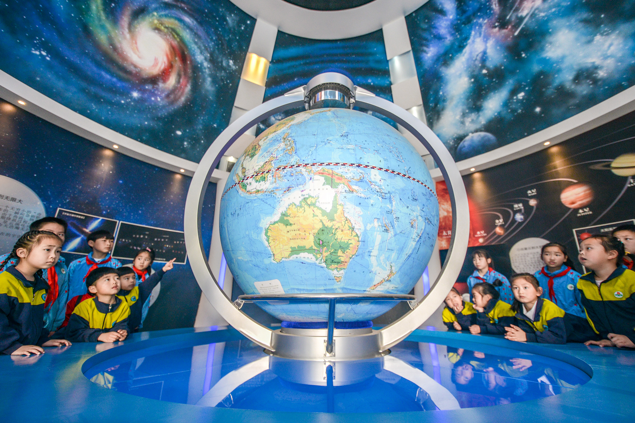
Celebrating Earth Day in Asia
Today, in China, children learn about the Earth at Changxing Jindingzi Geological Museum in Huzhou, East China's Zhejiang province, on April 21, 2021.
Every year on April 22, Earth Day marks the anniversary of the birth of the modern environmental movement in 1970. Chinese schools highlight environmental issues, including the loss of biodiversity and increasing pollution. The theme for this year's observance is "Restore Our Earth“, and teach students to protect the our earth.

Slide 93

We can do for today
One simple way teachers and parents can observe Earth Day is to take learning outside and have children interact with their environment.
Nature walks are a fun and easy way to bring your students outdoors, whether it’s on the school grounds, in your backyard, or at a park or another local place of interest.

Slide 94
International Earth Day
A Quote for today
“It seems to me that the natural world is the greatest source of excitement; the greatest source of visual beauty; the greatest source of intellectual interest. It is the largest source of so much in life that makes life worth living.”
– David Attenborough

Slide 95


Slide 96

April 23, 2021
Happy Friday
Today's Lesson:
Part I: English Language Day
Part II: High Speed Rail & Bullet Train in France

Slide 97
April 23, 2021
Happy Friday
The Six official languages of United Nation declared are English, Arabic (‘arerbik), French, Spanish, Chinese, and Russian. Each language has a day dedicated to it.

Slide 98

English Language Day

Slide 99

English Language Day What is this day?
English Language Day is celebrated on April 23 of every year.
English Language Day seeks to entertain and to increase awareness of the culture, history and the achievements of the English language.

Slide 100
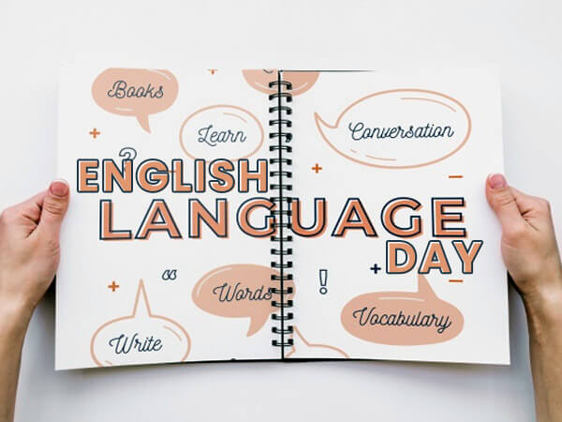

Slide 101
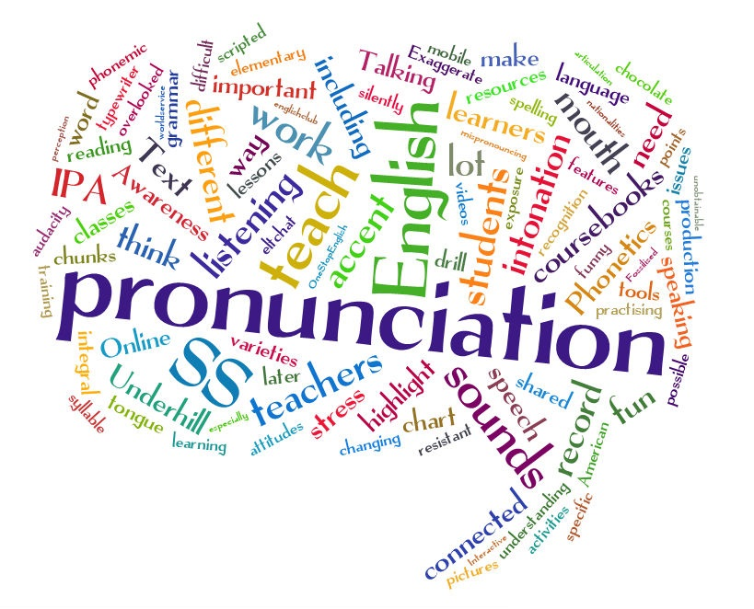

Slide 102
English Language Day
History of English Language Day
In 2010, the UNESCO (United Nations Educational, Scientific and Cultural Organization) founded the English Language Day to celebrate the multilingualism and cultural diversity as well as to promote the equal use of all six the official working languages throughout the organization.
They chose April 23, because the day marks the birthday of William Shakespeare (‘sheipier), the most famous and well celebrated English play writers and authors in the history

Slide 103

English Language Day
How to celebrate English Language Day
Celebrating the English Language Day is quite easy and simple to remember.
Just entertain and inform the people about the culture, history and the achievements of the English Language.
Spread awareness on social media by using the hashtags #English, #EnglishLanguageDay or #EnglishDay.

Slide 104
Qoute for today
“I don’t follow anything blindly. I have to know the entire thing if I have to get into it. It might sound funny to you, but it’s like using the English language.
I use an English word only when I know its meaning and understand its connotation. You won’t hear me say, ‘What’s up, dude’ or anything like that just for the heck of it.”
– By Kailash Kher

Slide 105

April 27, 2021
Terrific Tuesday
Today's Lesson:
Part I: School Bus Driver Day
Part II: High Speed Rail in Africa

Slide 106


School Bus Driver Day

Slide 107


School Bus Driver Day
Today we honor school bus drivers! School Bus Drivers' Day originated in California. After being observed there unofficially for some time, the California legislature decided to make the day official.
In 2009, they created the day "in order to draw special public attention to school bus drivers for their continued and excellent services to pupils in California."
After being created in the state, it appears the holiday spread to be observed informally elsewhere.

Slide 108

School Bus Driver Day History of the Day
The roots of buses—and school bus drivers—date to the late nineteenth century. During that time, a horse-drawn vehicle called a kid hack took children to and from school.
Since horses were at the hack's front, students entered the vehicle through the back, so they didn't startle them.
Following the first decade of the twentieth century, the vehicles that took students to school no longer had horses.
But, they still had perimeter bench seating that the kid hacks had, as well as doors for entering on the rear.

Slide 109

School Bus Driver Day
How to Observe
Here are a few ideas on how to celebrate the day:
If you ride a school bus, thank your school bus driver or send a gift to your bus driver.
If you are a school bus driver, make sure to let your coworkers and the students you drive know about the day.
If you would like to become a school bus driver, today is the perfect day to take steps to do so!
If nothing else, you could count how many school buses and school bus drivers you see today. Our guess is you will see a lot!

Slide 110

April 28, 2021
Wednesday
Today's Lesson:
Part I: International Noise Awareness Day
Part II: High Speed Rail in Africa

Slide 111

International Noise Awareness Day

Slide 112

International Noise Awareness Day
International Noise Awareness Day is a global campaign, founded in 1996 by the Center for Hearing and Communication (CHC), aiming to raise awareness of the effects of noise on the welfare and health of people.
Noise affects people in many ways, but only deafness and annoyance receive actual interest from the general public.

Slide 113
International Noise Awareness Day
Worldwide, people are called upon to take part via various actions on this occasion: open days on hearing, lectures in public health departments, universities and schools, panels of experts, noise level measuring actions, and readings.

Slide 114
International Noise Awareness Day
The day is commemorated on the last Wednesday of April of each year.
Activities aimed at creating a focus not only on noise, but also on means of reducing noise levels, are organized in a number of countries all over the world, including Brazil, Chile, Germany, Italy, Spain and the United States.
In recent years, there have been related events initiated in Asia, including China, Singapore and Japan.

Slide 115

April 29, 2021
Thursday
Today's Lesson:
Part I: Daily Event - National Zipper Day
Part II: Things to do in leisure time

Slide 116

National Zipper Day

Slide 117

National Zipper Day What is this day?
National Zipper Day is celebrated on the April 29 of every year.
National Zipper Day is observed to honour the thing that we just take for granted but we never thought of appreciating it. From jackets to pants, and handbags to boots, it is impossible to thing about the life without zippers.

Slide 118
National Zipper Day History of National Zipper Day
The origin and history of National Zipper Day are not known. One of the 1st documented versions of the zipper came in the year 1851 from an American inventor, Elias (i’lais hao) Howe.
He is often recognized as the inventor of the technology for sewing machines.
Elias Howe failed to market his zipper and he missed the appreciation he may have received. 42 years later in the late 19th century

Slide 119
National Zipper Day
How to Celebrate National Zipper Day
On National Zipper Day, Spend the day ‘contemplating zipper which is simple but essential to our day to day lives. Take this Day as an opportunity to read about the origin and history of Zippers.
Also, post pictures and share your thoughts about the day with others on social media using the hashtags #NationalZipperDay or #ZipperDay.

Slide 120
National Zipper Day
“The zipper displaces the button and a man lacks just that much time to think while dressing at dawn, a philo’sophical (filer’s)ficl) hour, and thus a ‘melancholy (‘melercherlli) hour.”
– Ray Bradbury

Slide 121

April 30, 2021
Happy Friday
Today's Lesson:
Part I: Daily Event - National Honesty Day
Part II: High Speed Rail in China

Slide 122

National Honesty Day

Slide 123

National Honesty Day What is this day?
National Honesty Day is celebrated April 30 of every year. On Honesty Day we celebrate frankness, trustworthiness, openness, and truthfulness.
This day was created to make people understand the importance of honesty and to motivate people to speak the truth.

Slide 124
National Honesty Day What is this day?
On Honesty Day, tell the truth frankly and openly.
National Honesty Day is observed on the last day of April strategically to balance out the falsehoods that we celebrate on the 1st day of April April Fool’s Day.

Slide 125
National Honesty Day HIstory of this Day
National Honesty Day was created by M. Hirsh Goldberg, the author of The Book of Lies in the early 1990s. M.
Hirsh Goldberg is also a former press secretary of Maryland, and he chose 30th April as Honesty Day for two reasons. First reason, April starts with the day that celebrates lies which is April Fool’s Day.
The second reason is that 30th April is the anniversary of the 1st inauguration (I”n):guleishein) of George Washington

Slide 126
National Honesty Day How to Celebrate National Honesty Day
On National Honesty Day, answer to everyone truthfully. If you are hiding something important and wanted to open up to someone, then this day is a perfect opportunity to share it.
If you have recently lied to someone, then try meeting that person and tell the truth. Also, tell everyone about this day on social media using the hashtags #HonestyDay or #NationalHonestyDay.

Slide 127
National Honesty Day How to Celebrate National Honesty Day
“Honesty is the fastest way to prevent a mistake from turning into a failure.”
– James Altucher (‘ao’tvcher).

